Slide 2
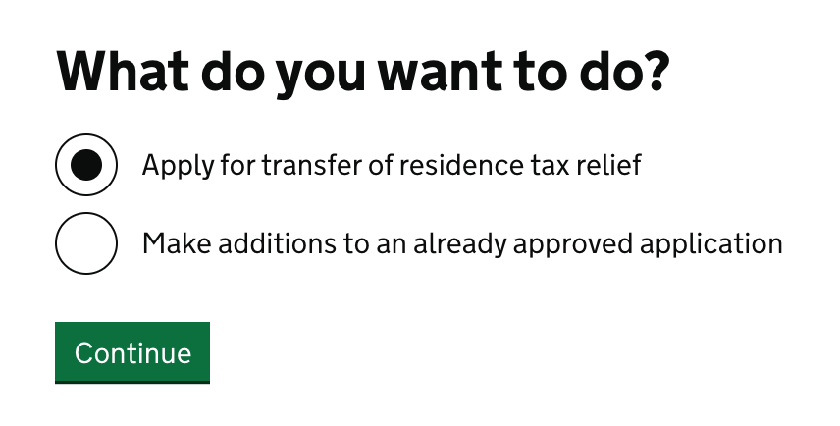

Slide 3
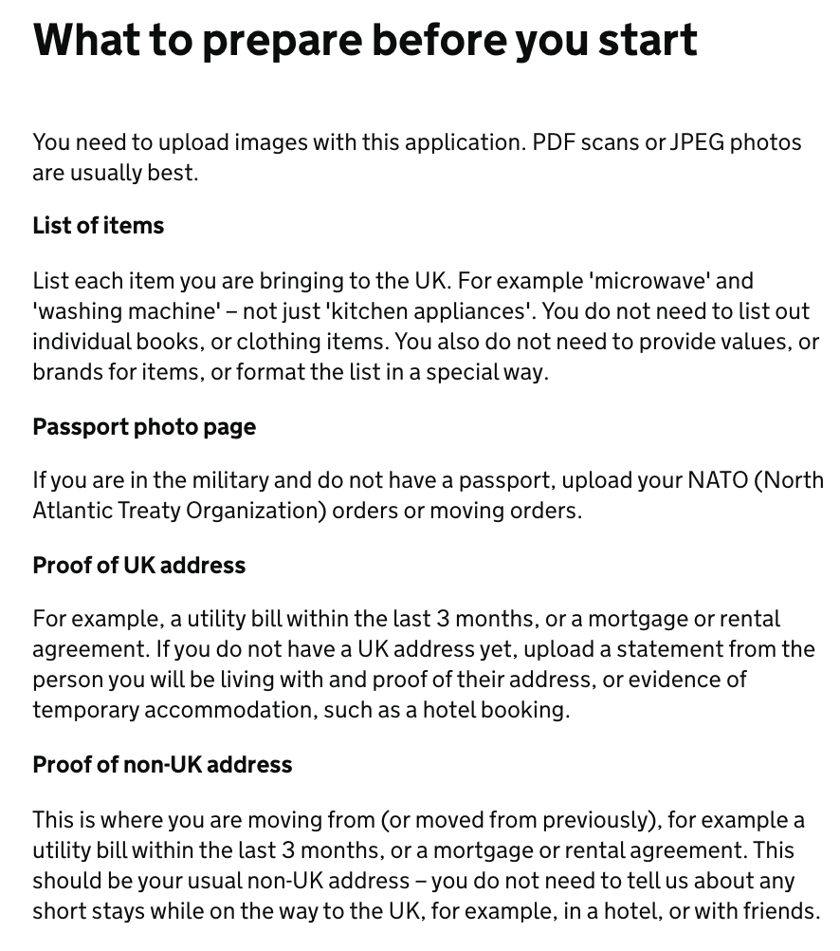
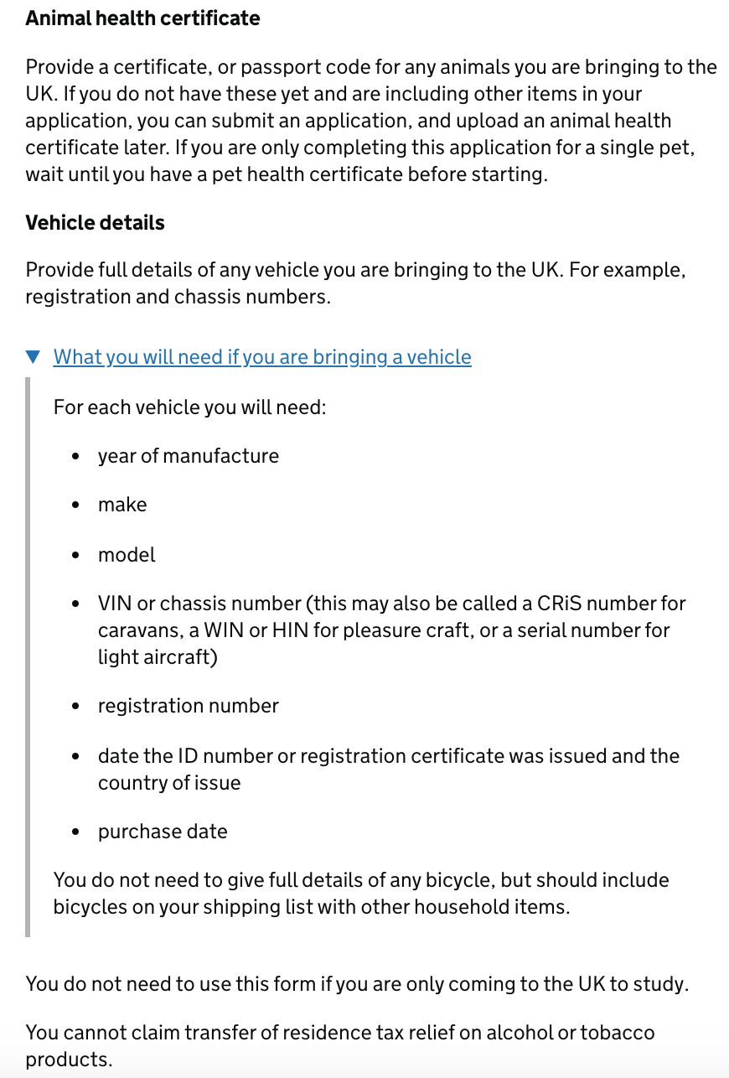

Slide 5
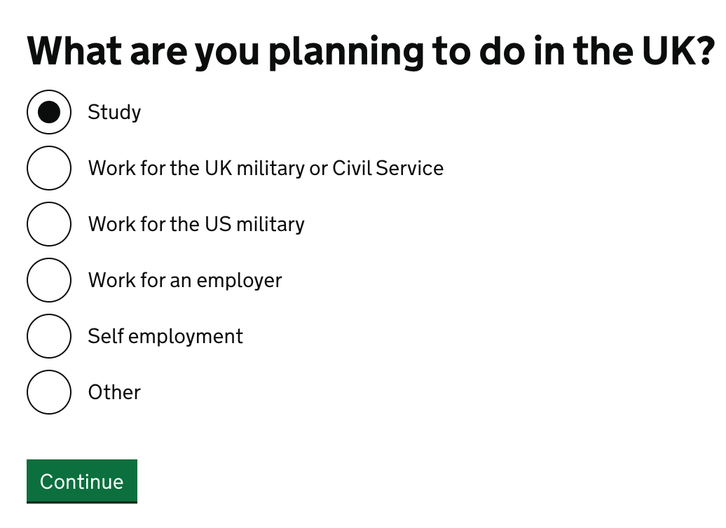

Slide 6
Updated page - 8 Feb

Slide 7
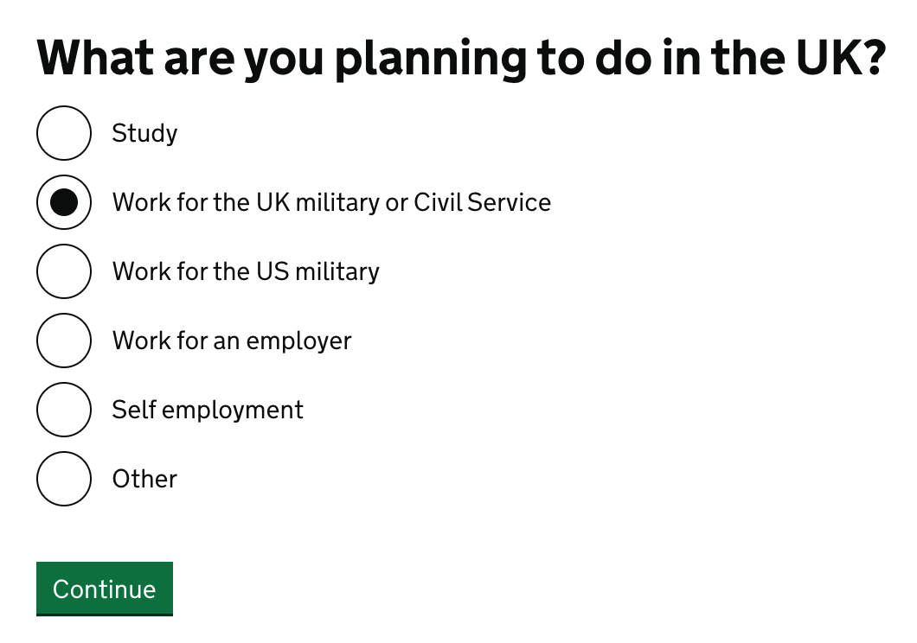

Slide 8
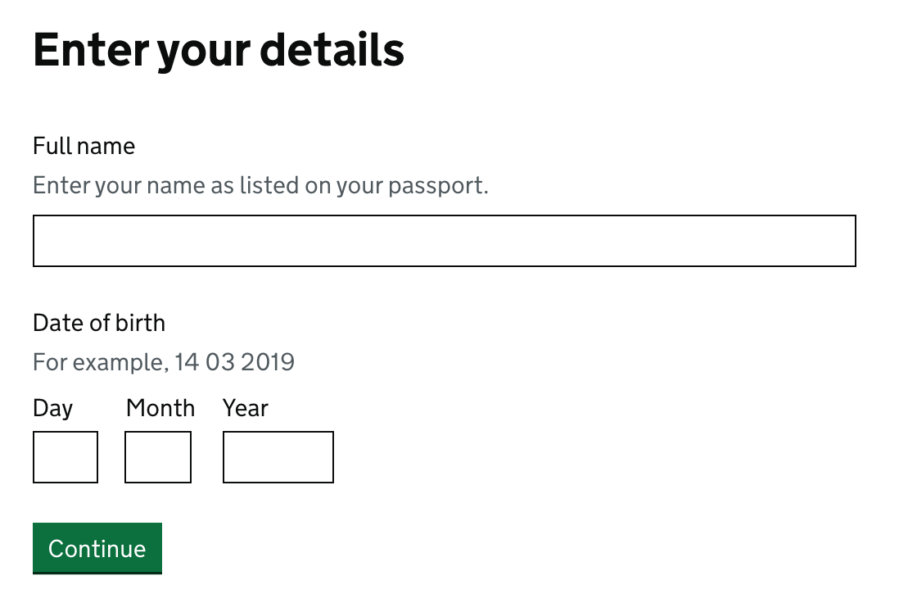

Slide 9
Updated page - 2 Feb
If civil service or military

Slide 10
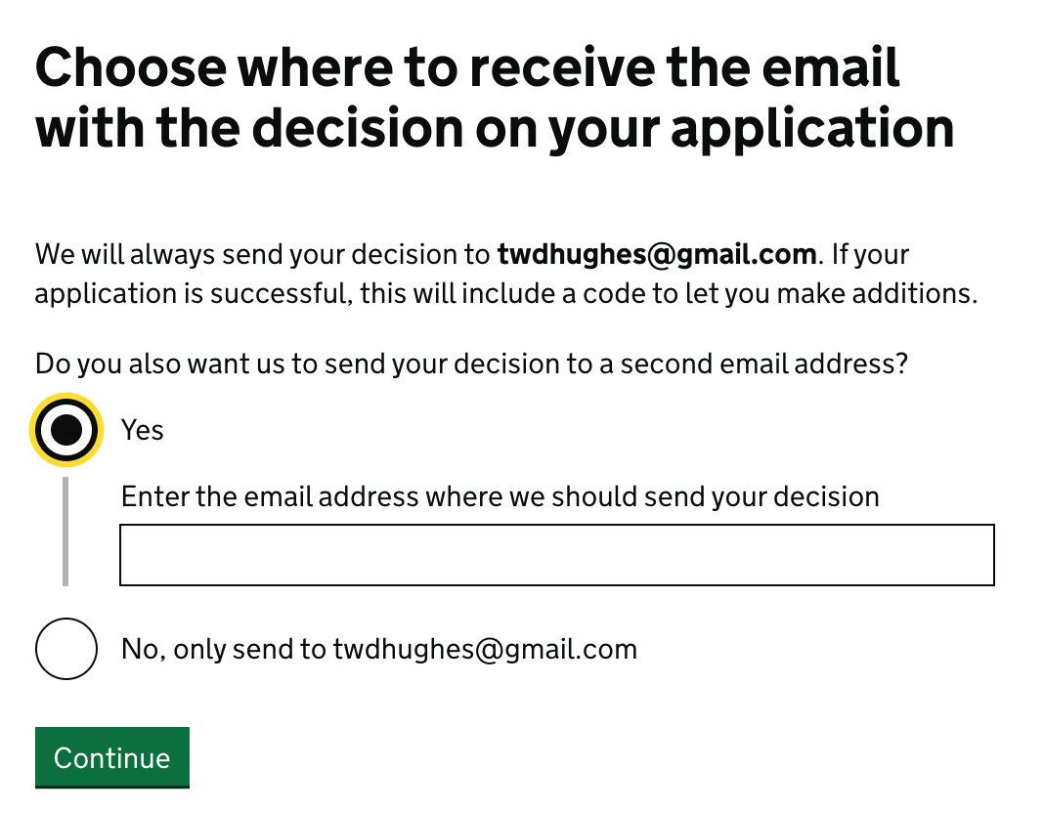

Slide 11
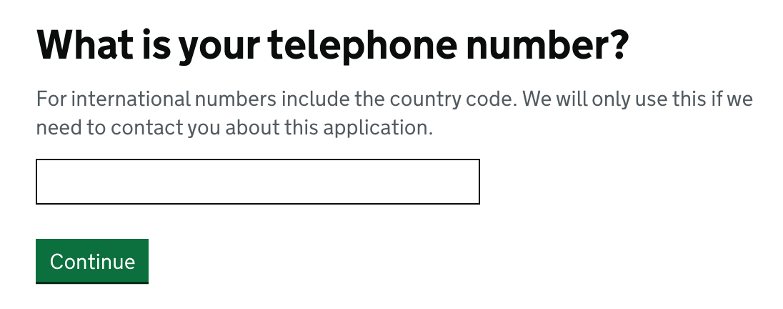

Slide 12
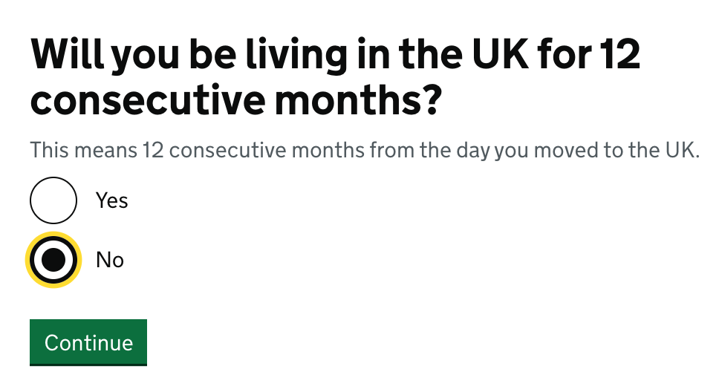

Slide 13
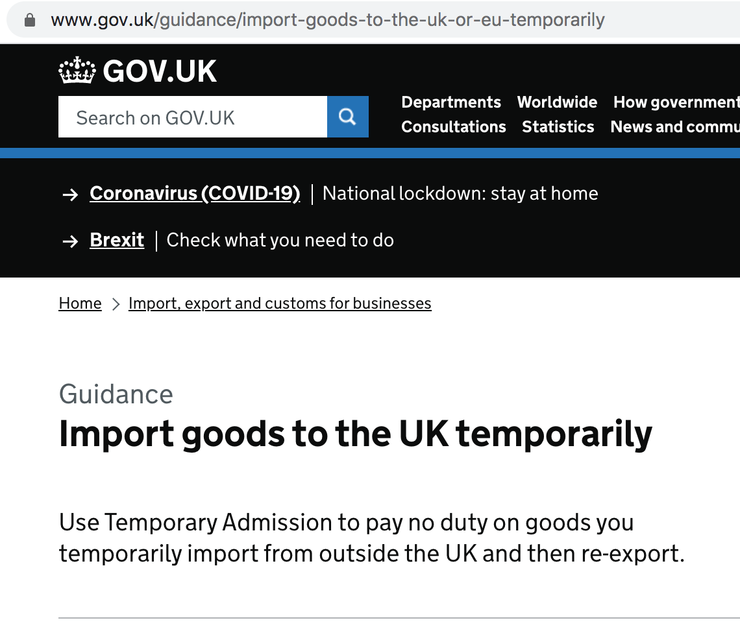
Updated page - 2 Feb

Slide 15
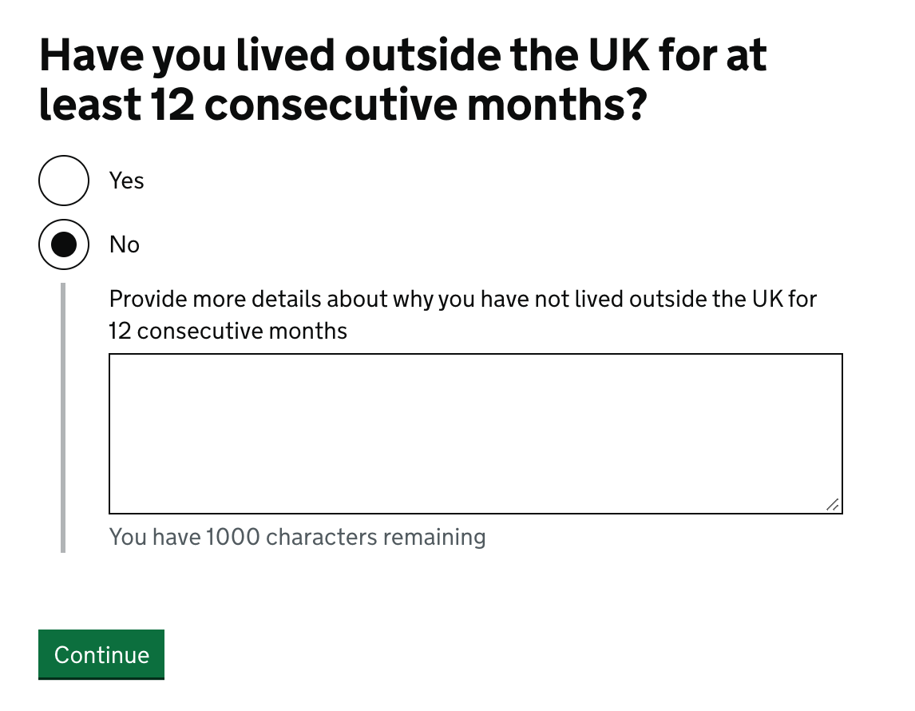

Slide 16
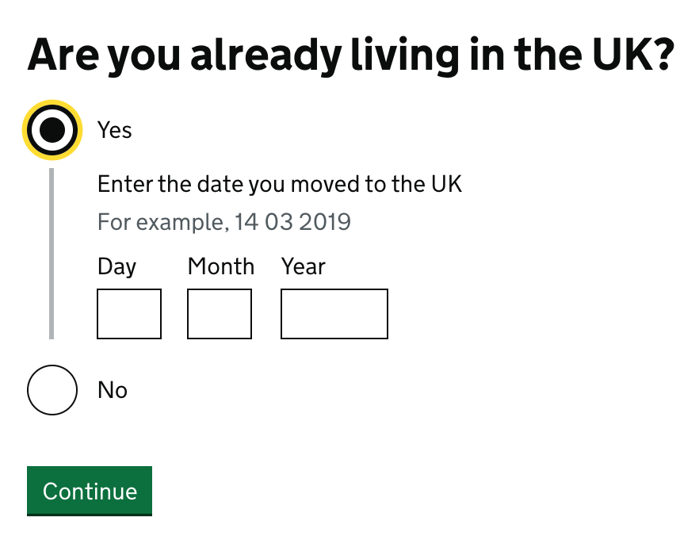

Slide 17
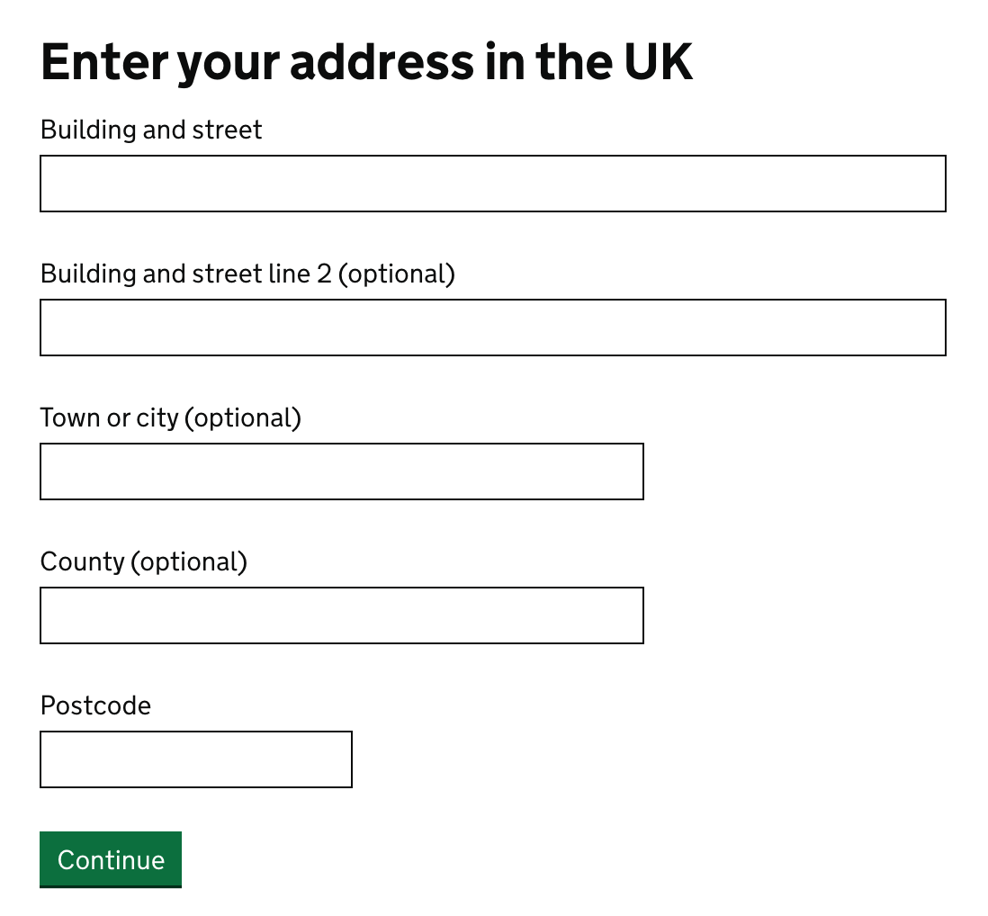

Slide 18
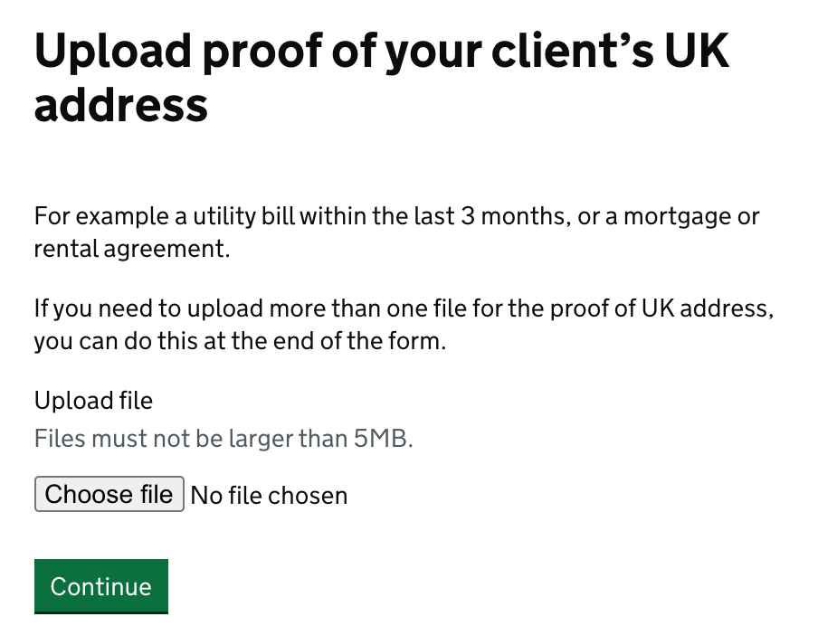
New mentions of ‘3 months’ on proof of address.

Slide 19
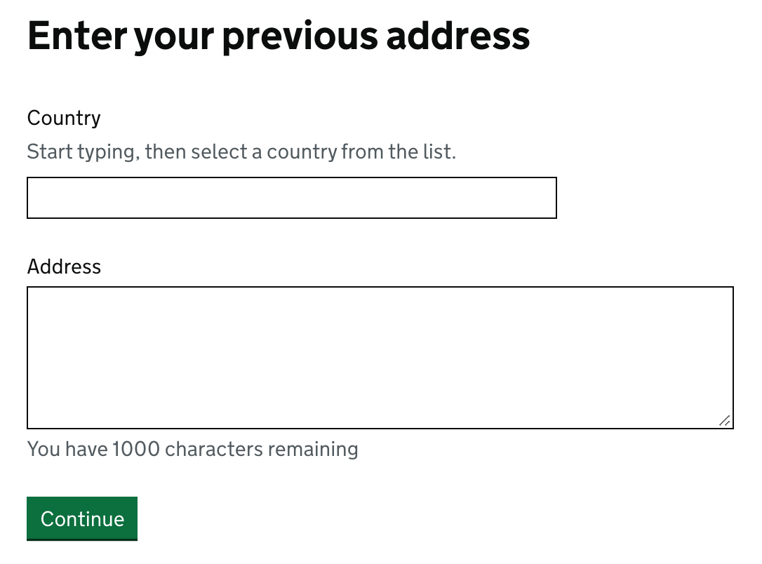

Slide 20
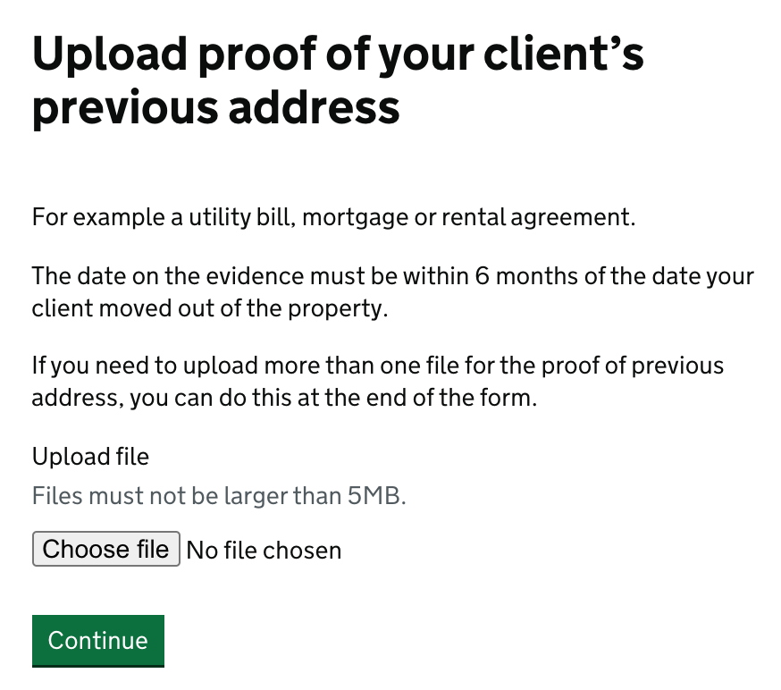
Note difference to the 3 month messaging - no change to this page.

Slide 21
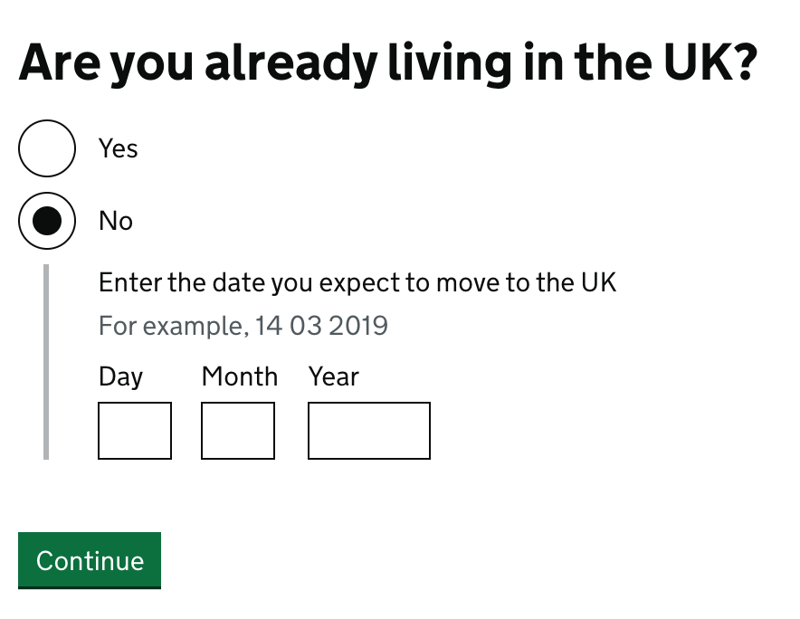

Slide 22
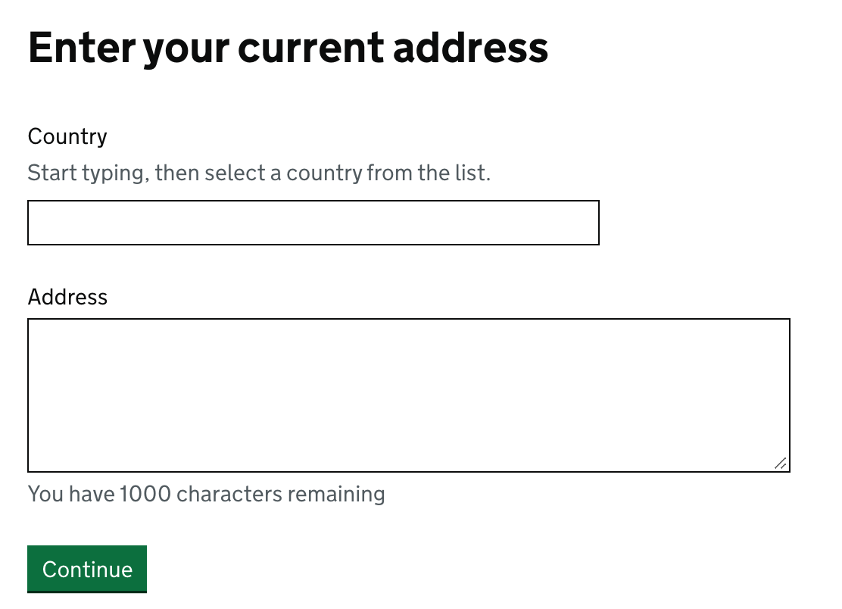

Slide 23
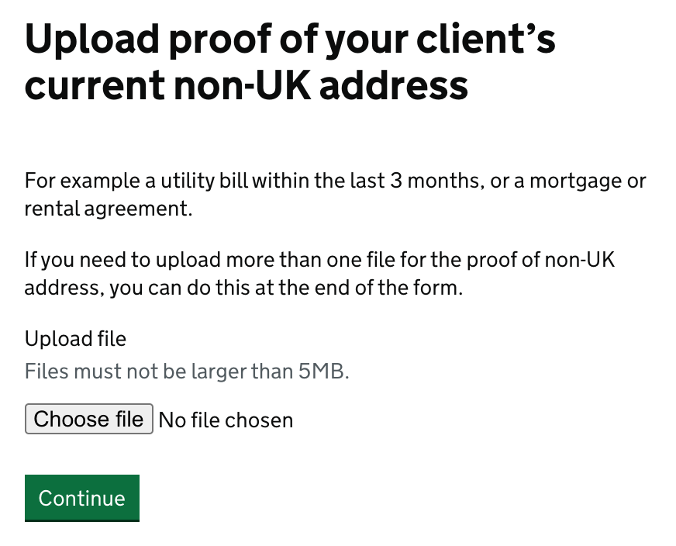
New mentions of ‘3 months’ on proof of address.

Slide 24
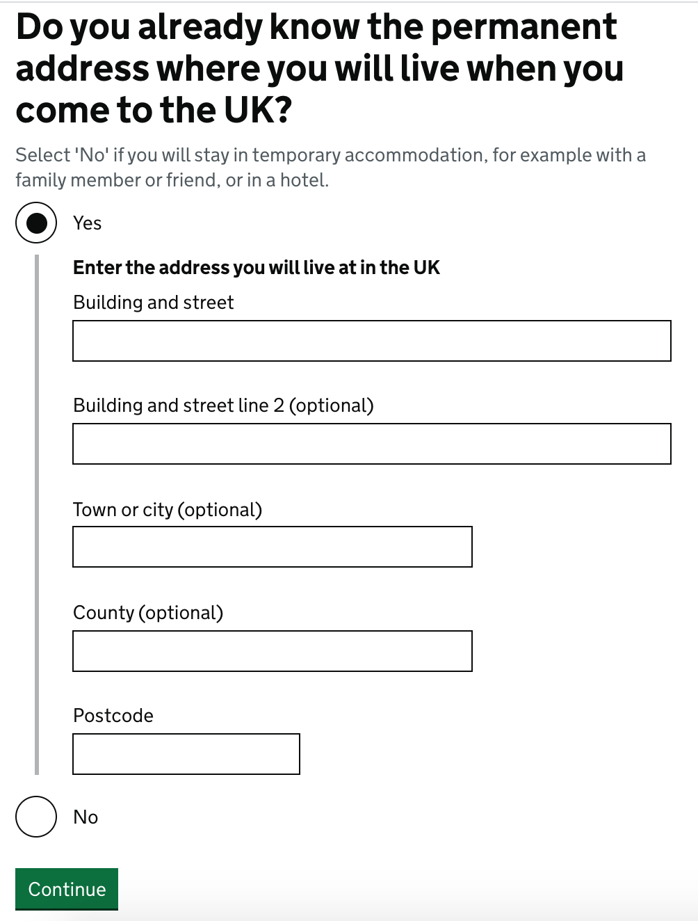

Slide 25
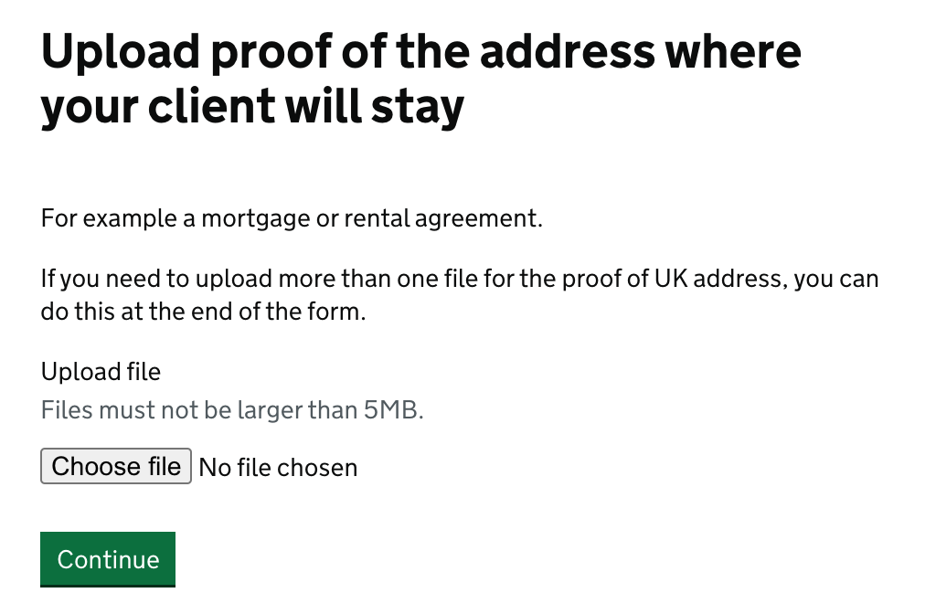
No mention of the utility bill at all, as seems to make less sense on this question.

Slide 26
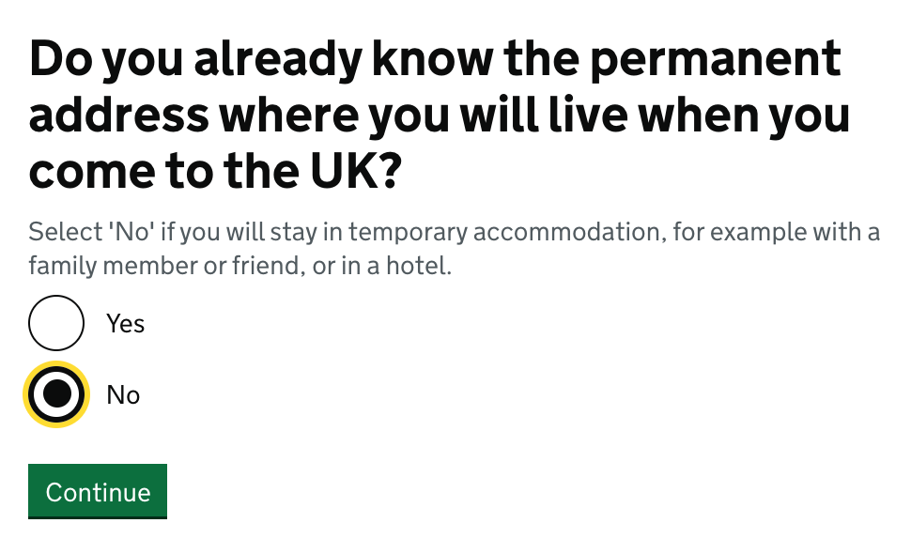

Slide 27
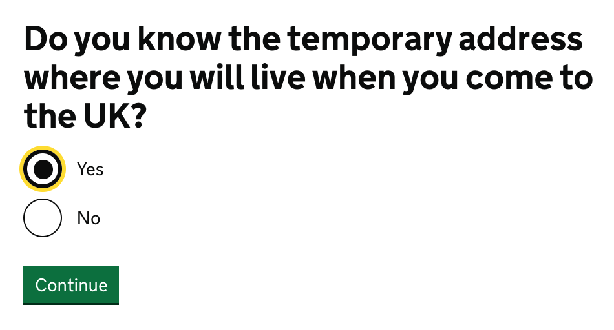

Slide 28
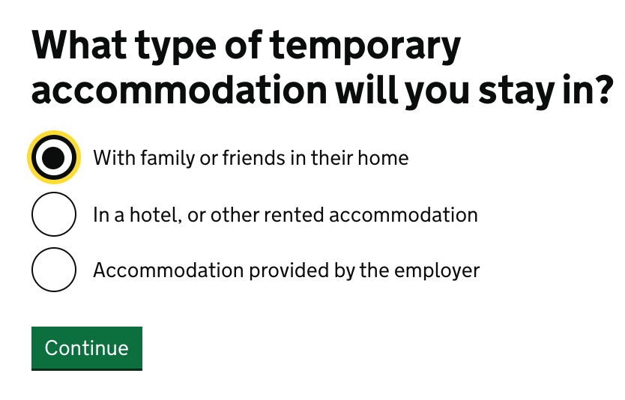
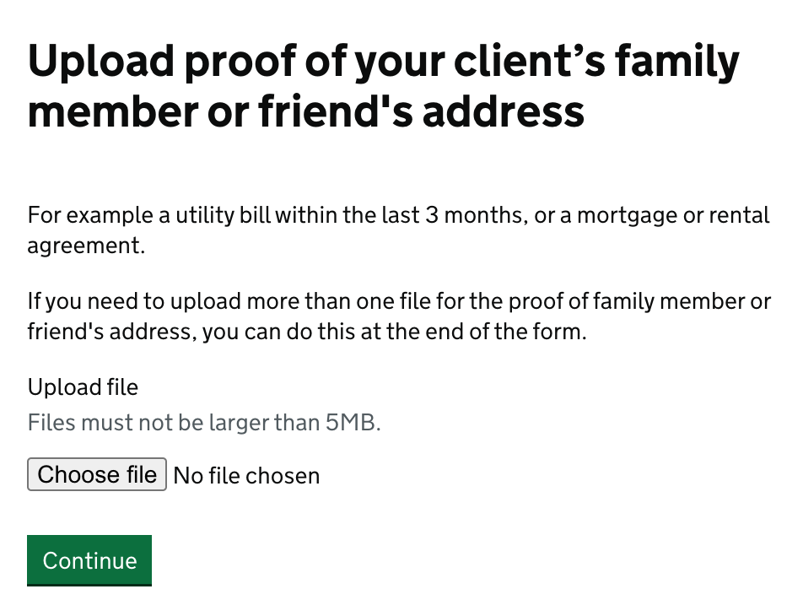
Updated page - 2 Feb

Slide 31
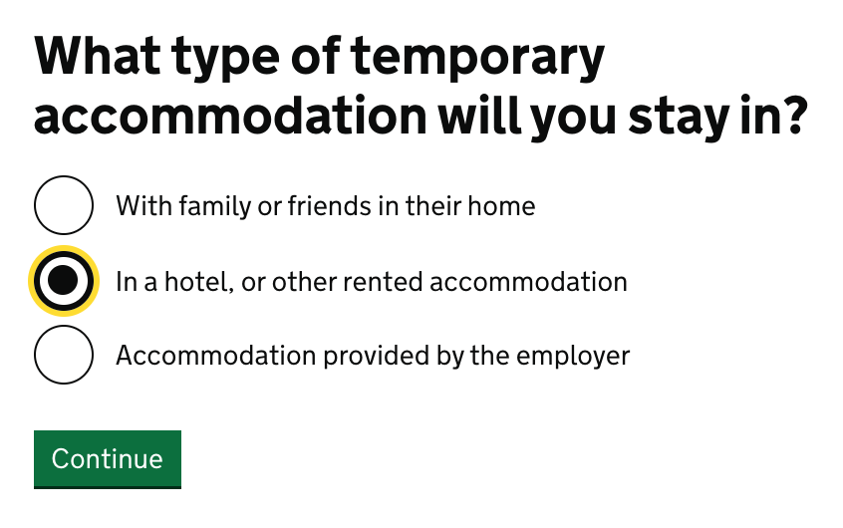
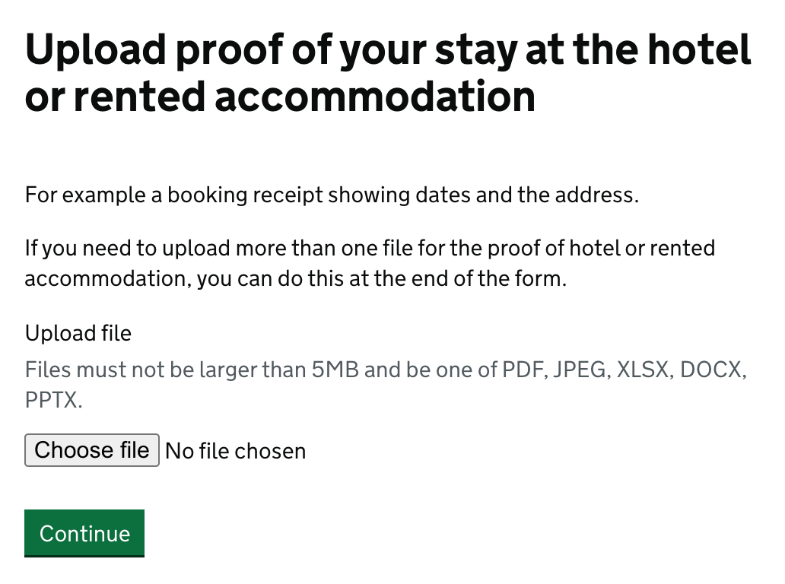
Updated page - 2 Feb

Slide 34
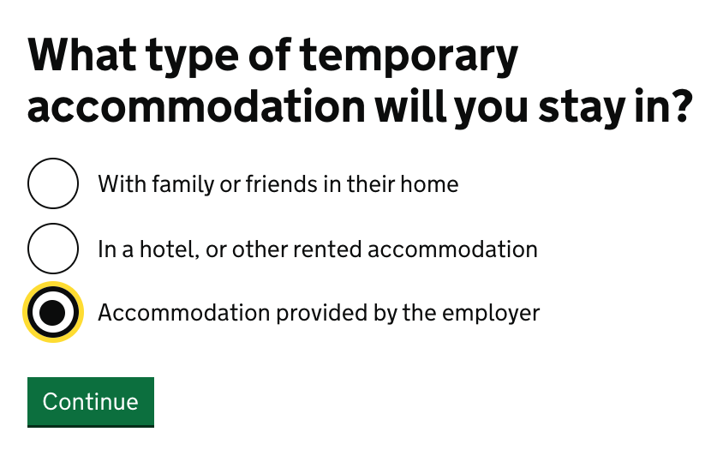
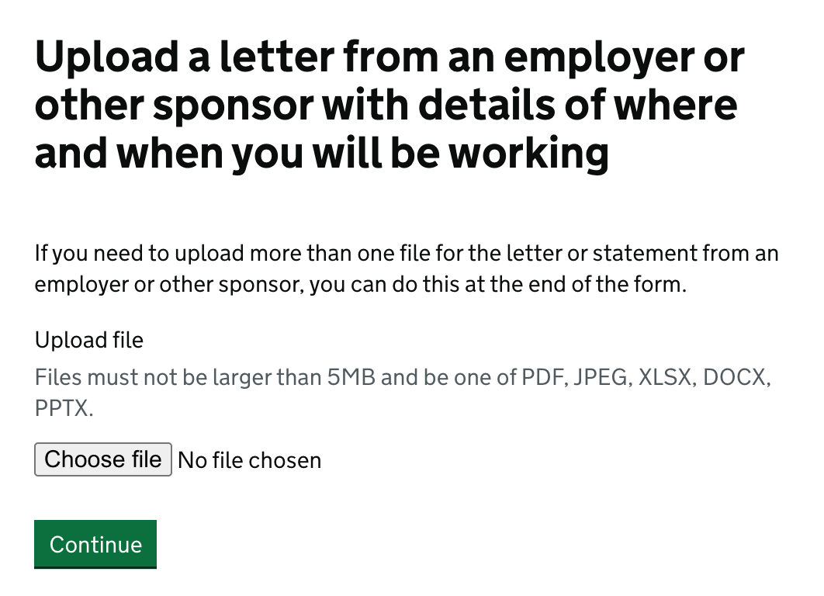
Updated page - 2 Feb

Slide 35
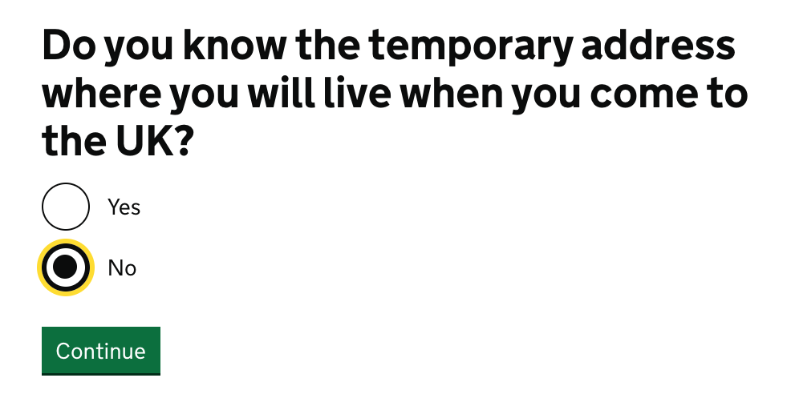
Updated page - 2 Feb

Slide 36
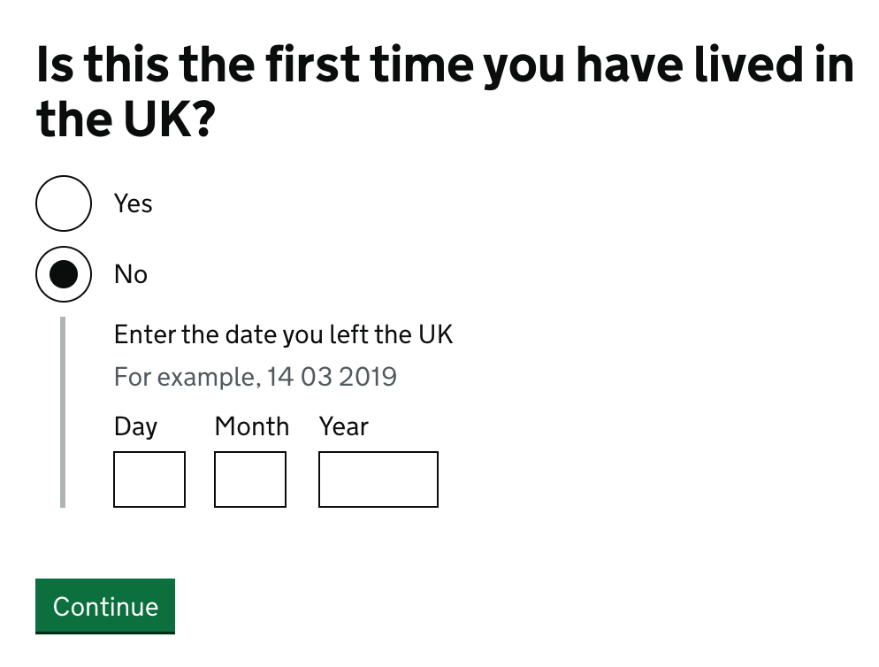

Slide 37
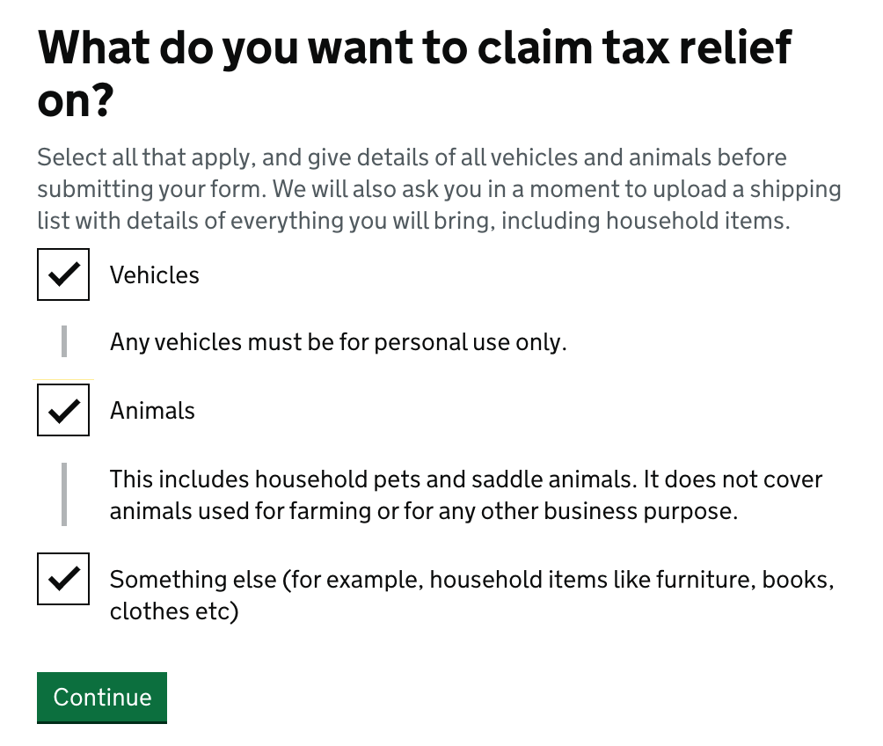
Updated page

Slide 38
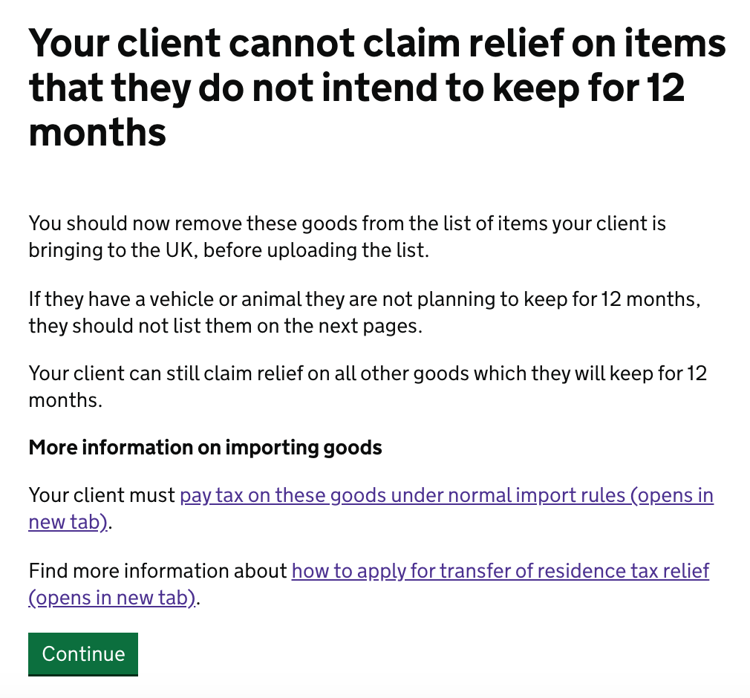

Slide 39
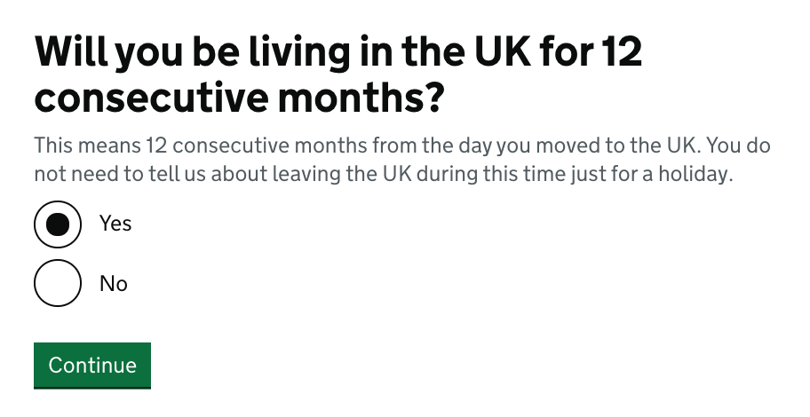
New mention of the ‘holiday’ message, due to recurrent user concerns about 12 consecutive months in UK.

Slide 40
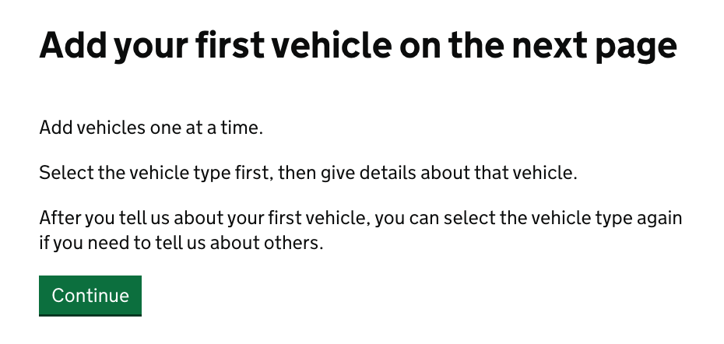
New page, after testing revealed need.

Slide 41
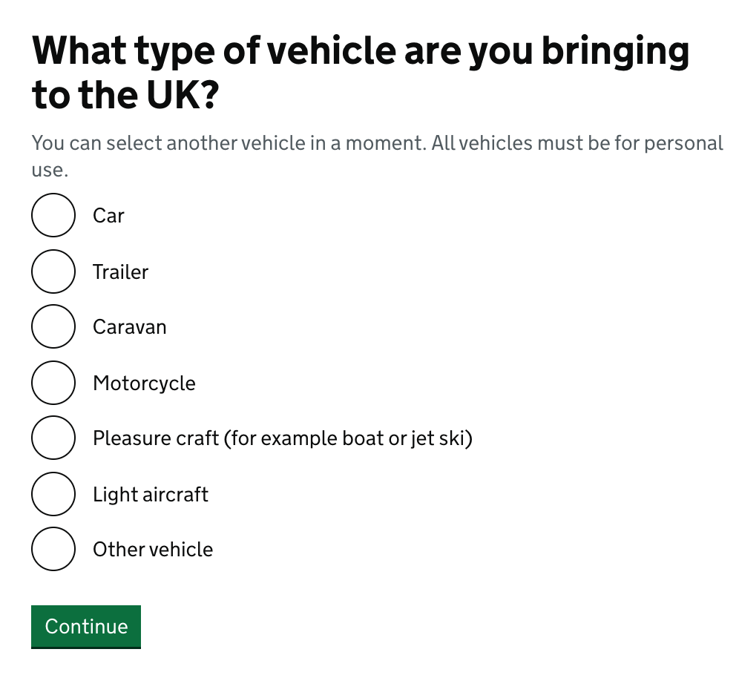
Updated page

Slide 42
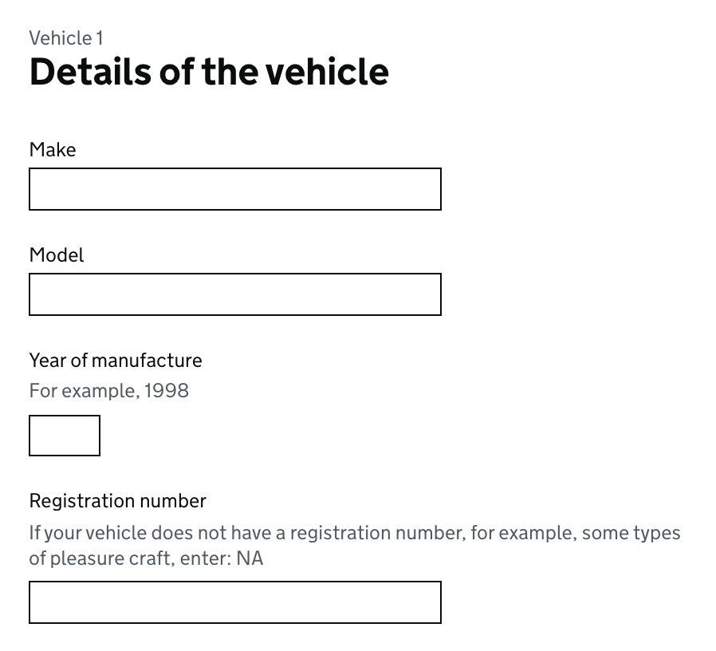
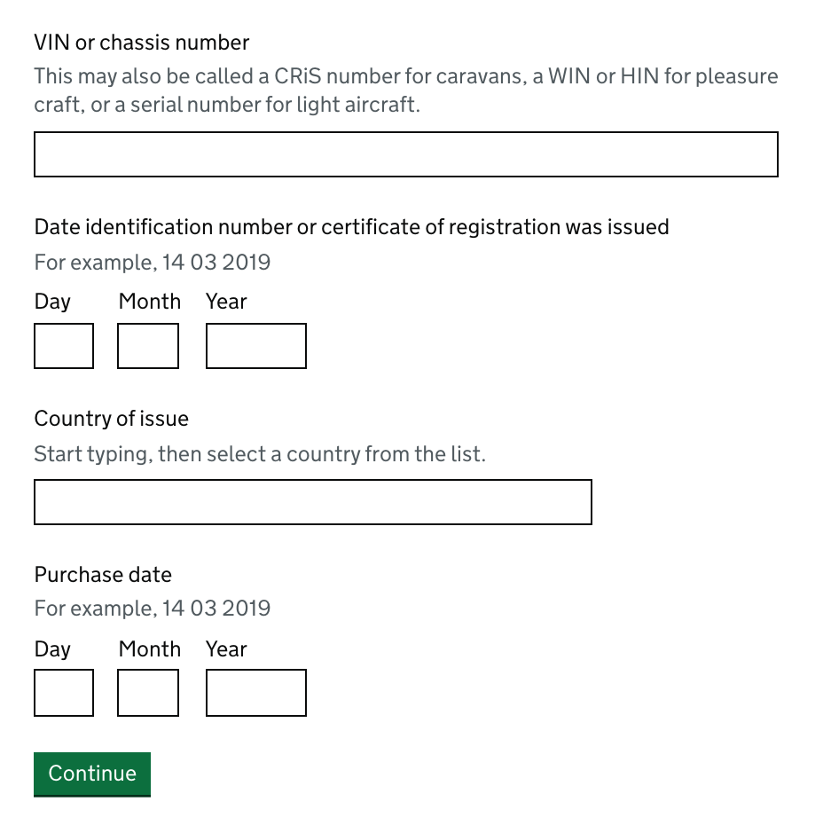

Slide 43
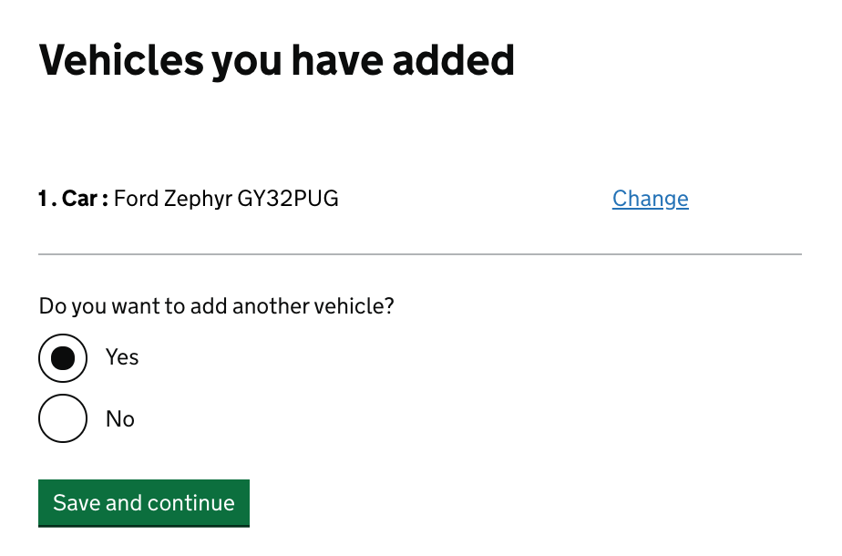

Slide 44
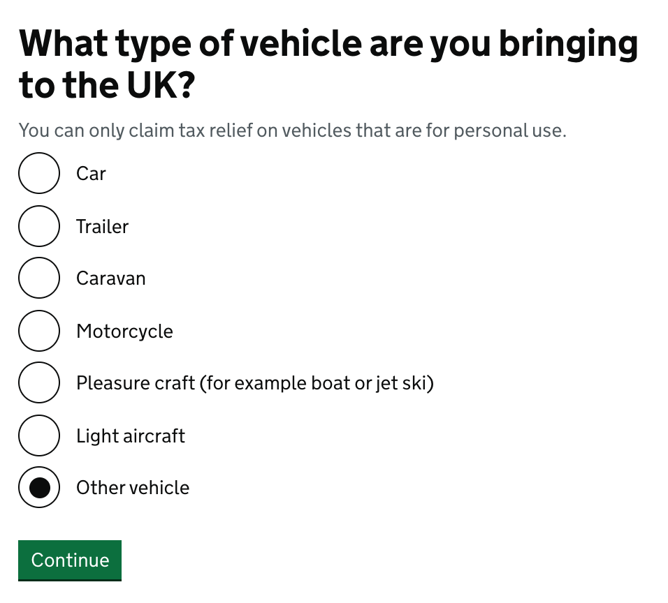

Slide 45
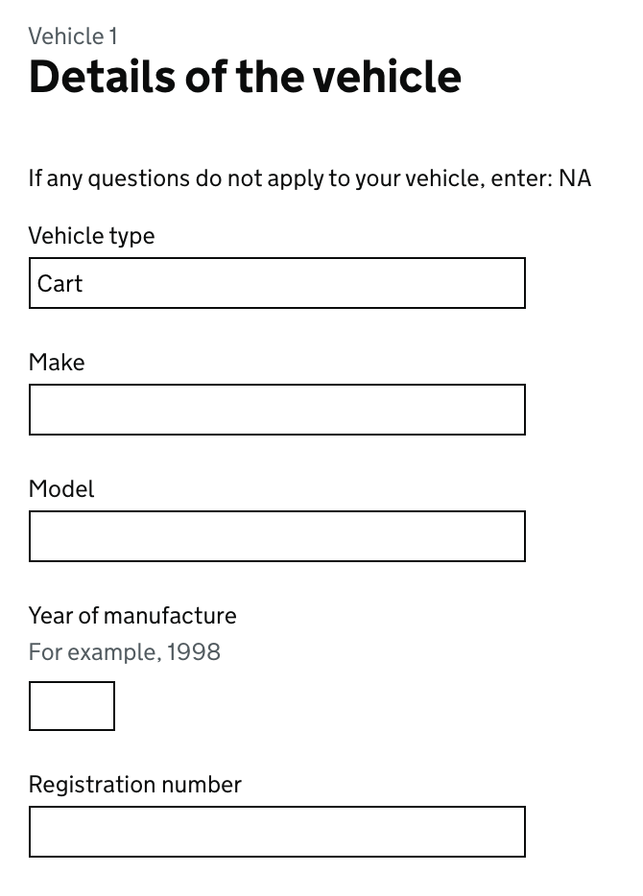
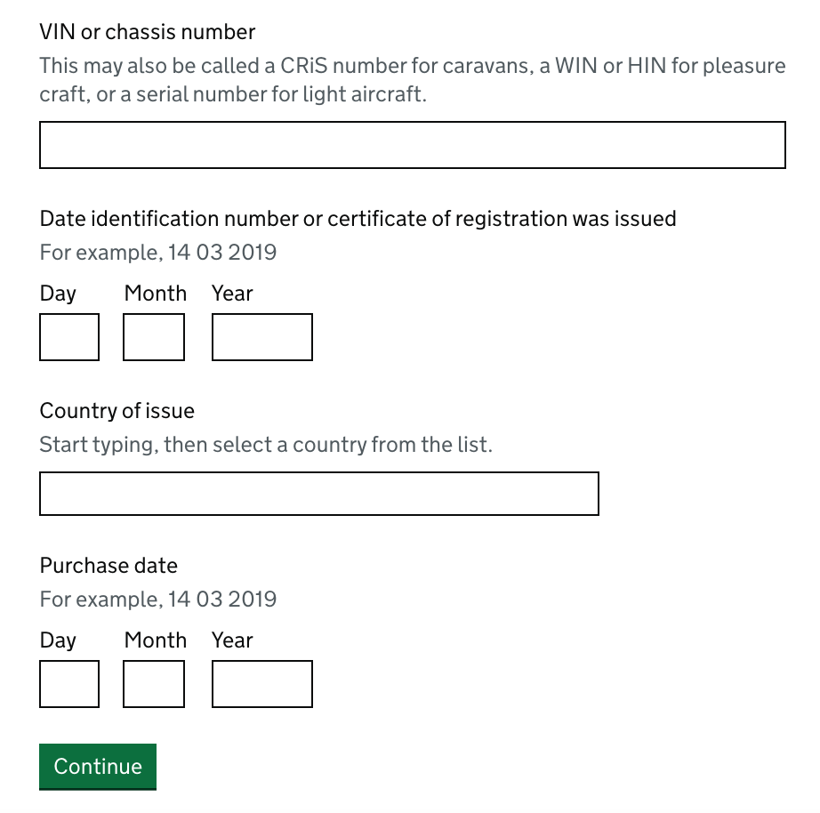

Slide 46
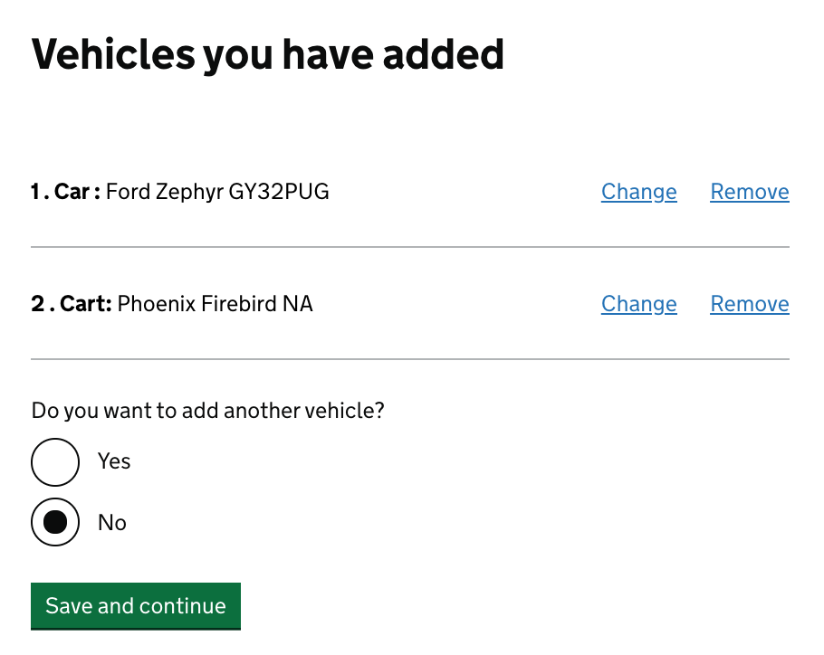

Slide 47
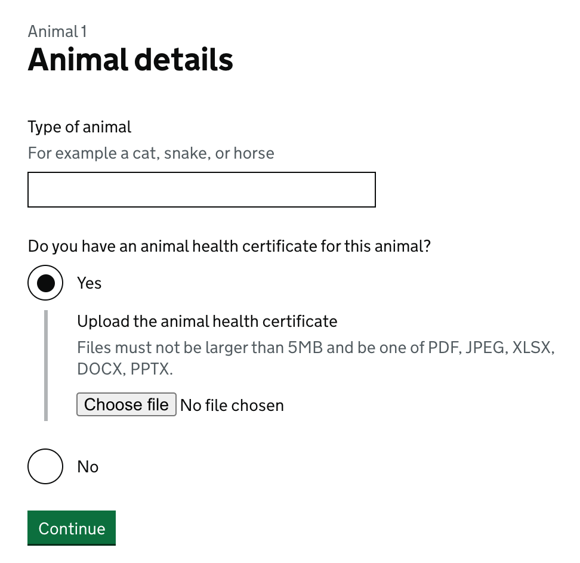

Slide 48
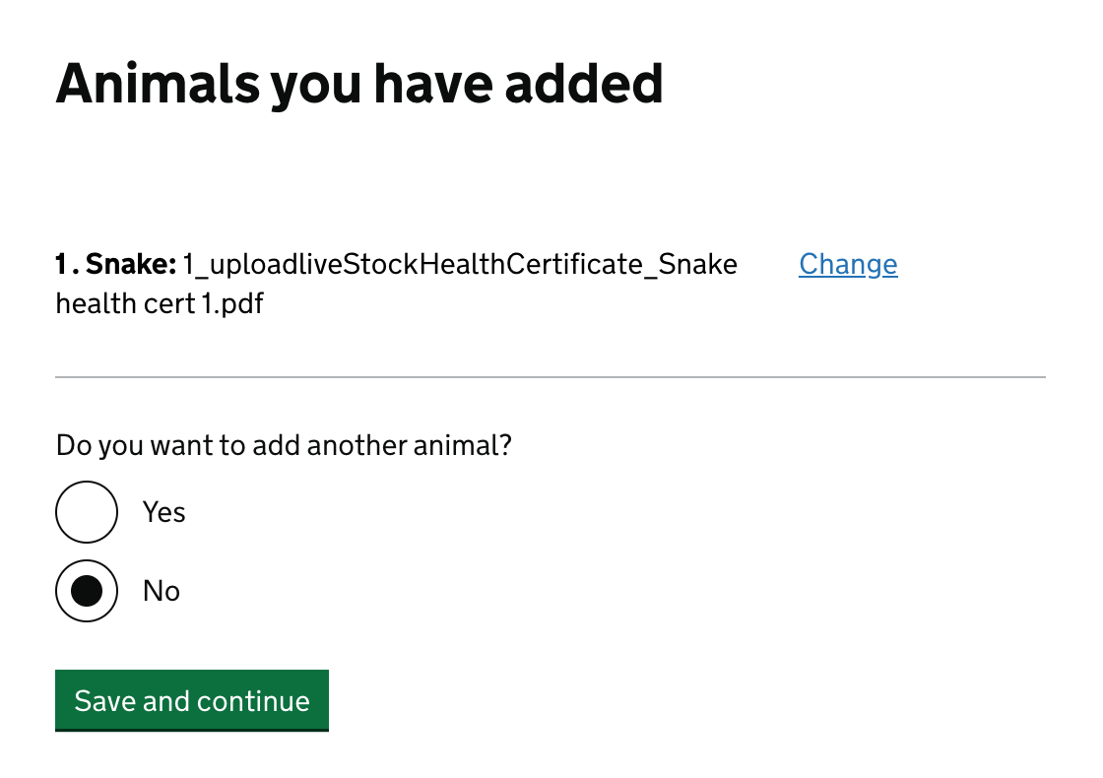

Slide 49
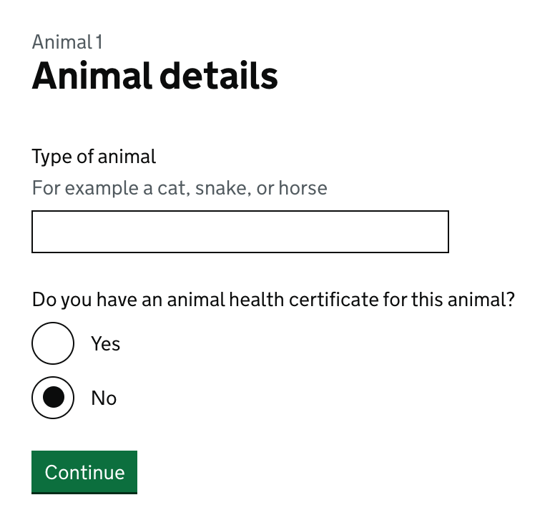

Slide 50
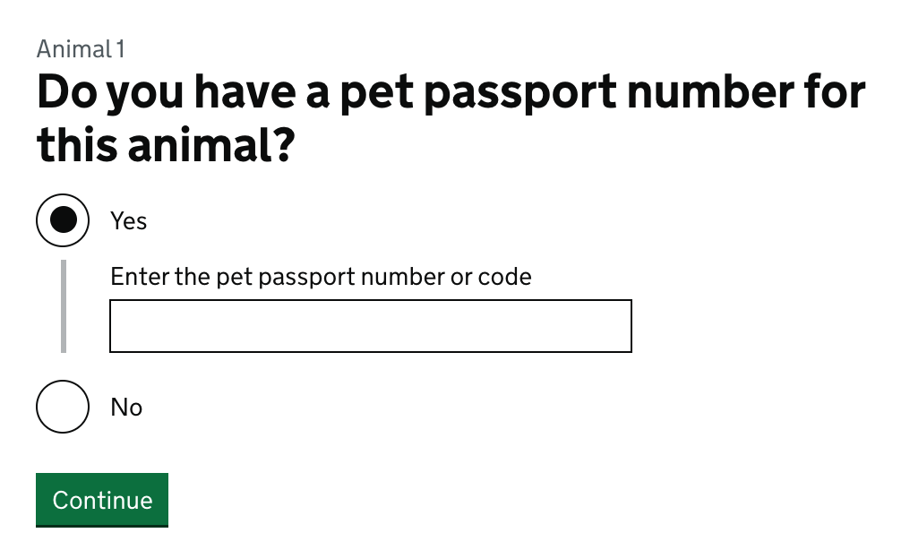

Slide 51
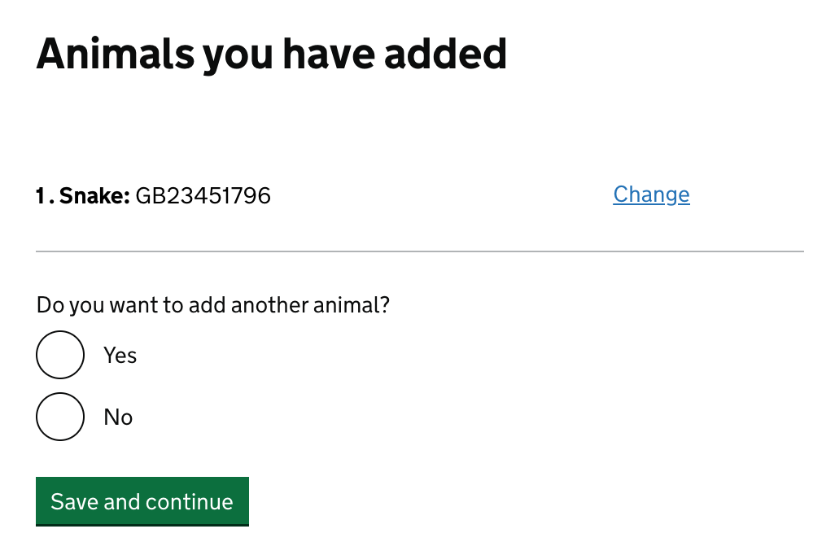

Slide 54
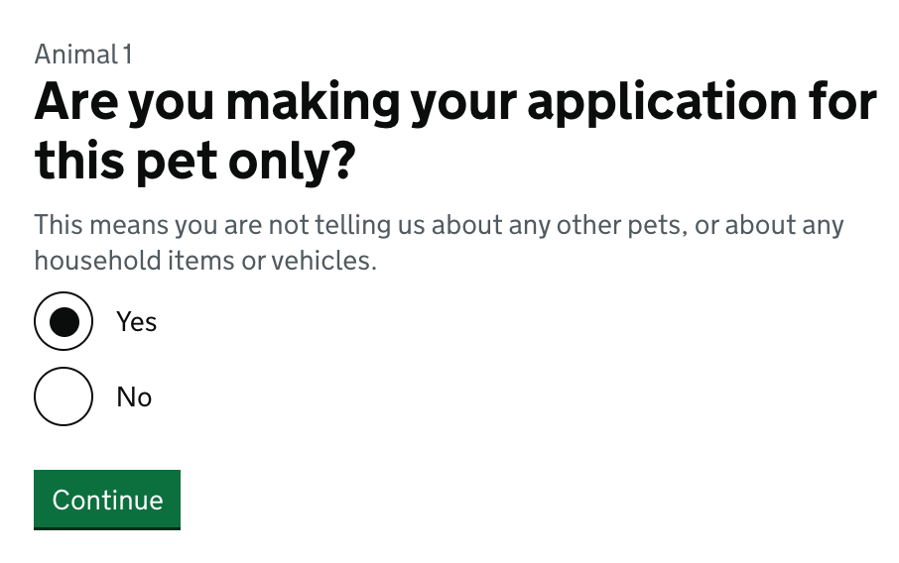

Slide 55
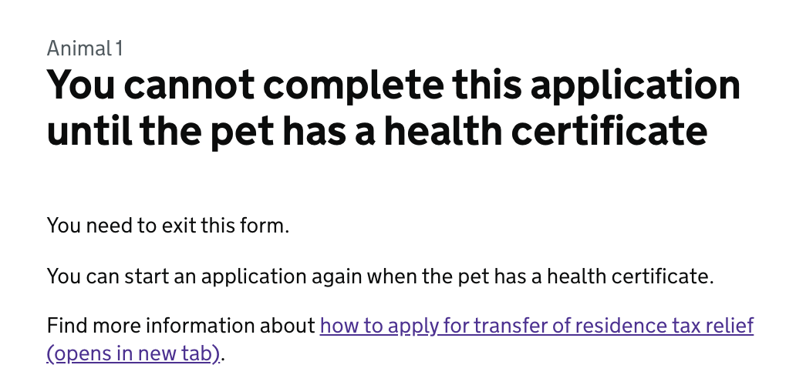

Slide 57
Updated page - 3 Feb

Slide 58
Updated page - 2 Feb

Slide 59
New mentions of ‘3 months’ on proof of address.

Slide 60
Change in heading and radio question to focus on ‘items’, not ‘shipping list’.

Slide 61
Scenario: All goods have arrived

Slide 64
Scenario: Some goods have arrived

Slide 67
Updated page - 3 Feb
Scenario: No goods have arrived

Slide 68
Updated page - 3 Feb

Slide 69
Updated page - 3 Feb

Slide 71
Clarification of what this question is asking, re: possession and ownership.

Slide 73
Updated page - 2 Feb

Slide 74
Updated page - 2 Feb

Slide 75
Updated page - 2 Feb

Slide 78
Propose we give the SLA as 15 working days to avoid misreading the 14 working days as ‘14 calendar days’, causing user worry.

Slide 79
This section needs to closely reflect the language which has tested well on the Gform ‘before you start’ page, including references to the shipping list.
More detail about format of list, plus info about any changes we make to address proof timescales.
More detail about format of list, plus info about any changes we make to address proof timescales, animal health certificates etc.

Slide 80
Users were very unsure that this was the correct button to use to make amendments.
This was due to the ‘start now’ wording, and no indication that amendments are made through the same access point.
We need to draw attention to the amendments here, and highlight it’s the correct place.

Slide 81
New email - to mirror confirmation page.

Slide 82
Agent journey - question variations

Slide 87
Updated page - 2 Feb

Slide 88
Additions journey

Slide 91
Then, as per regular journey

